Slide 1
Which industries are more vulnerable under 2020 financial crisis in America?
MIS 637 Final Project
Instructor: Prof. M. Daneshmand
Accomplished by: Ling Ao

Slide 2
Content
Problem Statement (Business understanding phrase)
Data Collection (Data understanding phrase)
Data Processing (Data preparation phrase)
Methodology (Modeling phrase)
Software & Package
Result
Discussion (Evaluation phrase & Development phrase)
Conclusion
Reference

Slide 3
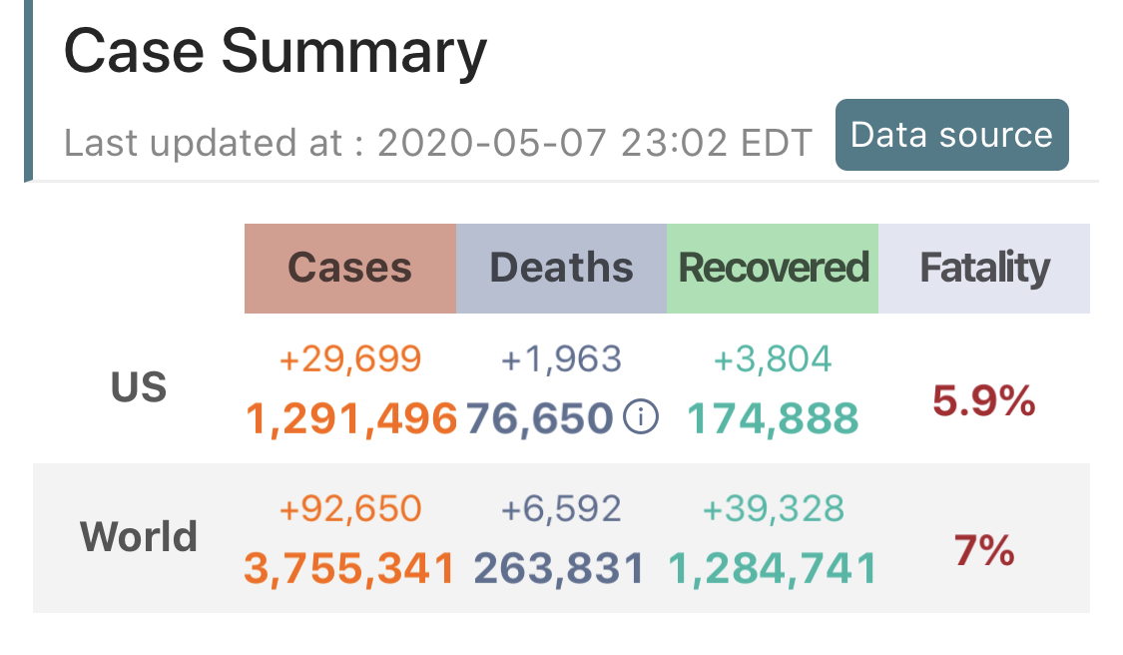
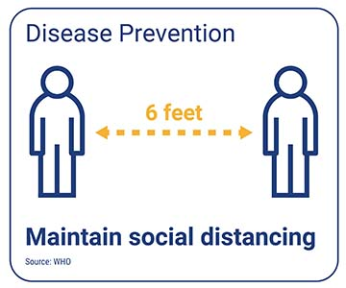
Problem Statement_ Business Understanding
Most cities have imposed quarantine order during this
special period and lots of companies let employees
work from home.
A new kind of virus, called COVID-19, is spreading around
the world. Based on the information from 1point3Acres,
there are around 1.29 million cases in America up to May 7th .

Slide 4

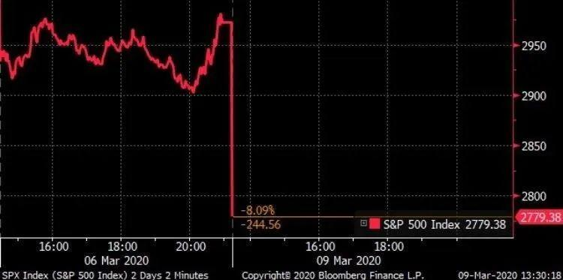
Problem Statement_ Business Understanding
In last three months, the economy of the United States has been greatly affected due to COVID-19
In March 9th, the S&P 500 fell by 7% upon opening, triggering a circuit breaker that halted trading for 15 minutes for the first time since the 2008 financial crisis. In May 12th , 16th,18th S&P 500 triggered the circuit breaker again
The financial crisis in America has came
Research Question:
Which industries are more vulnerable under 2020 financial crisis in America?

Slide 5
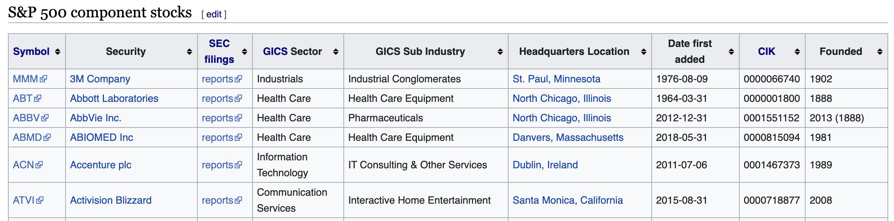
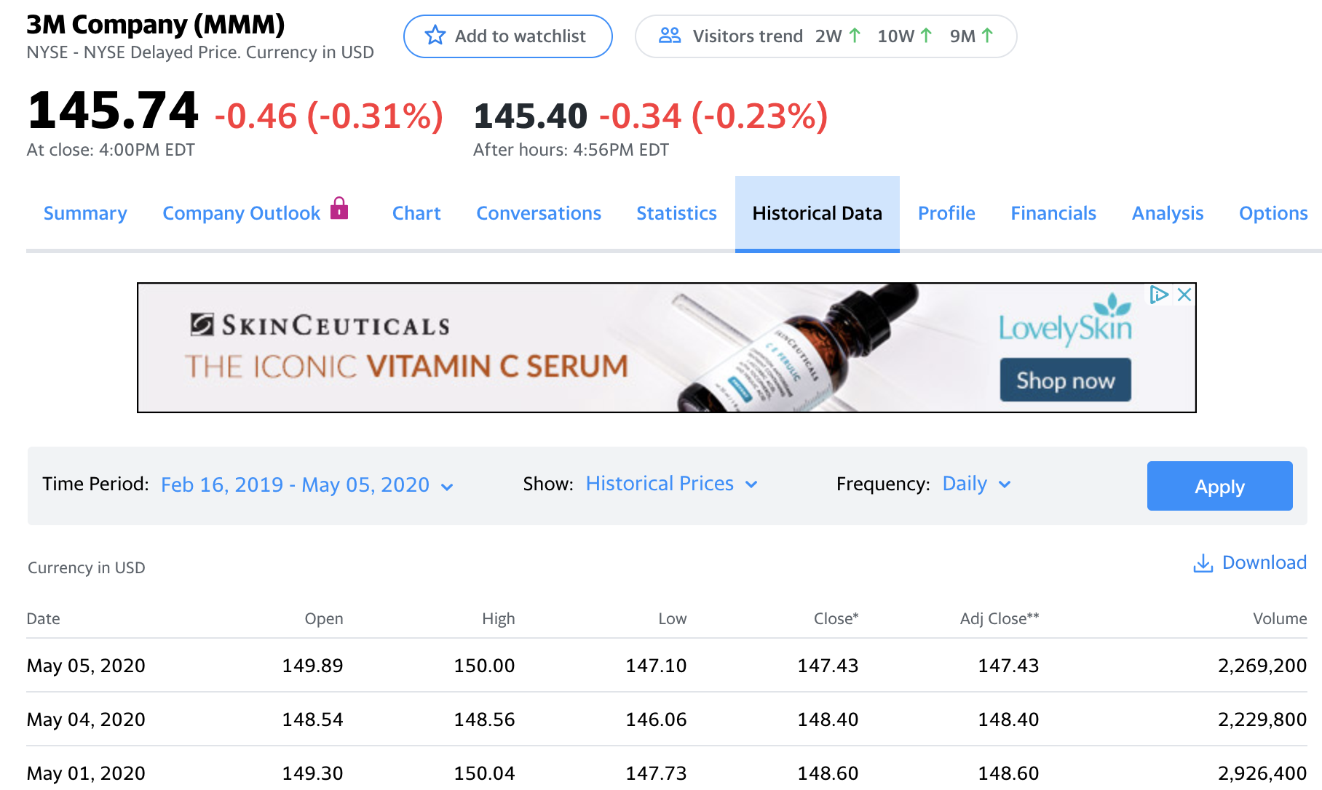
Data Collection_ Data understanding
1) Information about all 505 companies contained in S&P500 index list in Wikipedia
Contain: Stock Symbol, Security (company name), SEC filings, GICS Sector, GICS Sub Industry, Headquarters Location, Date first added, CIK and funded year.
2) Weekly adjusted close stock price of each share in S&P500 from February 17th until May 5th from Yahoo Finance website.

Slide 6
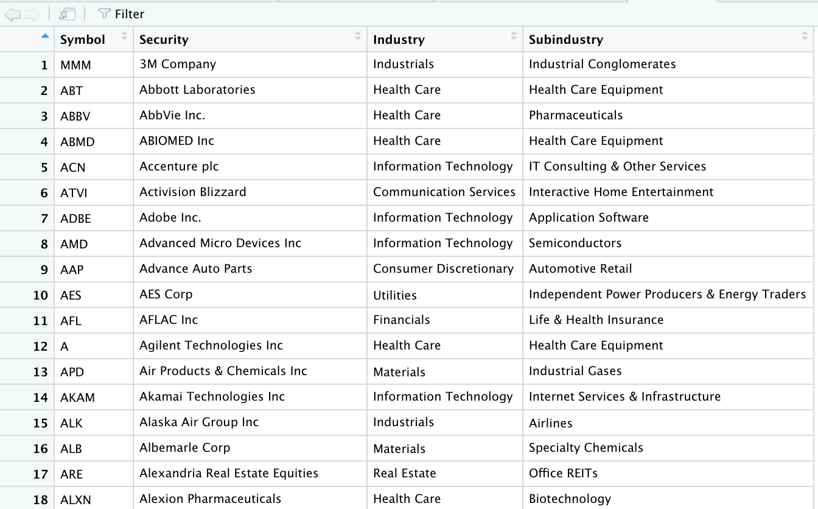
Data Processing_ Data Preparation
1) Imported “S&P 500 data. csv” into R
2) Deleted the possible N/A value contained in the dataset
3) Chose the first four columns of the dataset and named them as 'Symbol', 'Security', 'Industry', 'Subindustry' respectively
4) Used “unique” function to delete the possible repeat column in the dataset.

Slide 7
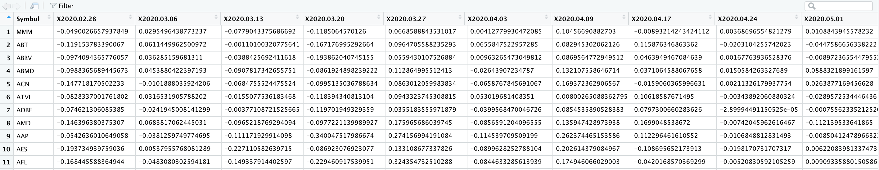
Data Processing_ Data Preparation
5) Installed and library the R package 'quantmod'
6) Used 'quantmod' package to gain all the daily adjusted closed price of each company from Yahoo Finance website; however, there were five companies didn’t have complete weekly data, I deleted the five companies.
7) Used 'quantmod' package to calculate the weekly return of each company from February 17th until May 5th, totally 10 weekly returns

Slide 8
Methodology_ Modeling
K-Means clustering
Goal
Maximizing the homogeneity or similarity of records within a cluster and minimizing the similarity of different clusters
Clustering all companies in S&P 500 based on the stock volatility
Steps
Randomly chose 3 points as cluster center, K=3
Calculated the Euclidean Distance from each point to each center and chose the nearest center for each point
Calculated the BCV and WCV values and calculated BCV/WCV
Calculated the next iteration until find the max value of BCV/WCV

Slide 9


Software & Package
Package: Quantmod
This package is a quantitative financial modeling and trading
framework for R. It can gain the data from Yahoo Finance
website and calculate the periodic return directly.
Software

Slide 10
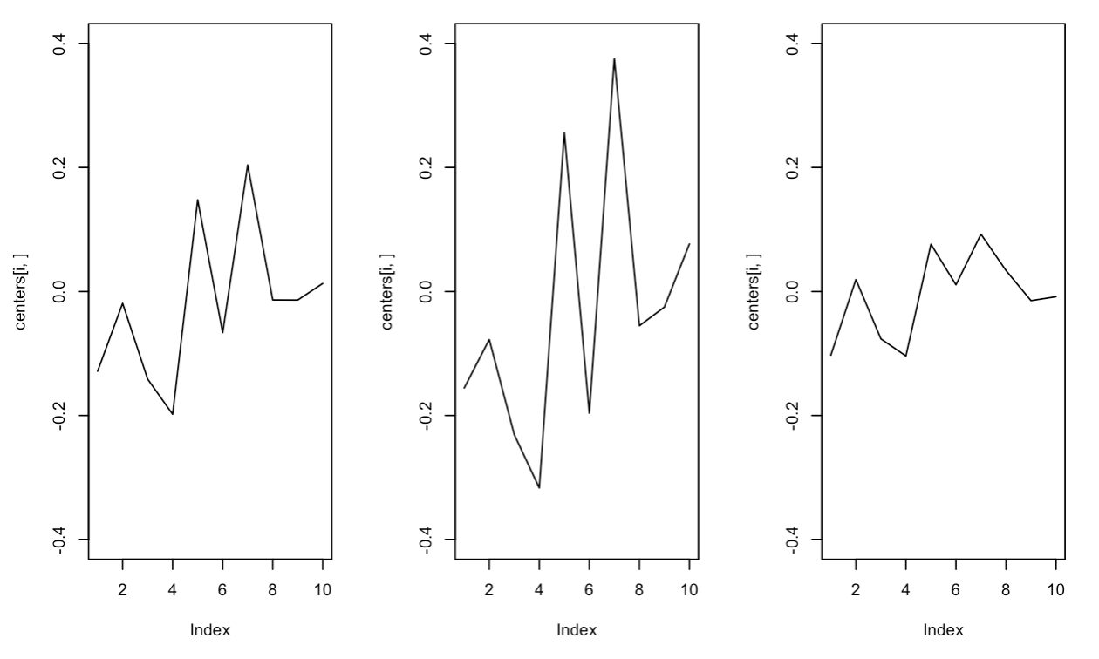
Result
These are the plots of the three clusters
According to the graphs, we can know that the volatility of the three clusters is median, high, low separately
Cluster1 contains 232 companies, cluster 2 conations 65 companies and cluster3 contains 203 companies.
Cluster 1
Cluster 2
Cluster 3

Slide 11

Result
Based on the above table, there were totally 11 industries: Communication. Service; Consumer. Discretionary; Consumer. Staples; Energy; Financial; Healthy. Care; Industrials; Information. Technology; Materials; Real. Estate; Utilities
First row showed the companies belonged to cluster 2, which has the highest volatility
Second row showed total number of the companies in the industry
Third row showed the ratio of first two rows
According to the results, Consumer. Discretionary industry had the highest volatility and Consumer. Staples had the lowest volatility

Slide 12

Discussion _ Evaluation
In order to evaluate the results I got, I also calculated the companies belonged to cluster3, which had the lowest volatility
After calculating, I found the ratio of Consumer. Discretionary industry had the highest ratio, which showed that this industry is most stable. Although Utilities industry had the lowest ratio, the ratio of Consumer. Discretionary is relatively low.
The evaluation results were consistent with the results I calculated before, so I got the right answer

Slide 13
Discussion _ Evaluation
Consumer. Discretionary industry contains four sub industry groups: Automobiles & Components, Consumer Durables & Apparel, customer service and retailing. Most of these products are non-necessary. Thus, the industry was not stable under financial crisis.
Consumer. Staples industry contains Food & Staples Retailing; Beverages; Food Products; Household Products, Personal Products. These products are necessary product. Thus, the industry has been less affectable under financial crisis is reasonable.

Slide 14
Discussion _ Development
Use other clustering methods
For example:
Hierarchical clustering with three different methods:
single, complete and average
Consider more features as the metrics to do divide cluster
Such as: future, bond, fund

Slide 15
Conclusion
The economy of the United States has been greatly affected due to COVID-19 in the past three months.
In order to find out which industries are more vulnerable under 2020 financial crisis in America, I used the stock price of S&P 500 index in Yahoo Finance to deal with the problem.
K-means algorithm, Software R, package quantmod were used.
The results showed that Consumer. Discretionary industry is most volatile due to the leverage, and Consumer. Discretionary industry is most stable.

Slide 16
Reference
Cai, J. (2007). What's in the news? Information content of S&P 500 additions. Financial Management, 36(3), 113-124.
Oyelade, O. J., Oladipupo, O. O., & Obagbuwa, I. C. (2010). Application of k Means Clustering algorithm for prediction of Students Academic Performance. arXiv preprint arXiv:1002.2425.
Ryan, J. A., Ulrich, J. M., Thielen, W., Teetor, P., Bronder, S., & Ulrich, M. J. M. (2020). Package ‘quantmod’.
Yuan, X., Xu, J., Hussain, S., Wang, H., Gao, N., & Zhang, L. (2020). Trends and Prediction in Daily New Cases and Deaths of COVID-19 in the United States: An Internet Search-Interest Based Model. Exploratory Research and Hypothesis in Medicine, 5(2), 1.
https://en.wikipedia.org/wiki/List_of_S%26P_500_companies
https://en.wikipedia.org/wiki/Global_Industry_Classification_Standard
https://finance.yahoo.com/

